Slide 1
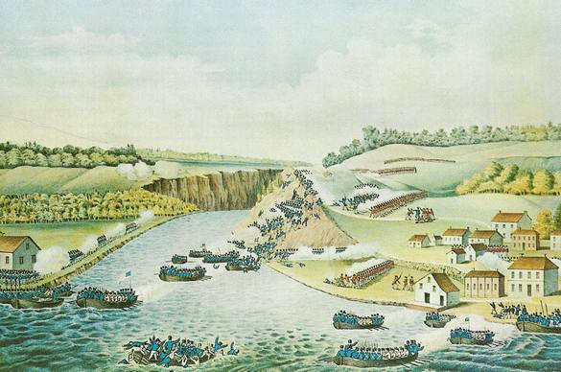
“Death, Hell, or Canada”
Simon St. Laurent
http://livingindryden.org/1812/
The History Center November 8, 2014
1836 engraving based on sketch by British Major James B. Dennis
This presentation is licensed under a Creative Commons Attribution-ShareAlike 3.0 Unported License.

Slide 2
Why the War of 1812?
American neutrality in the Napoleonic Wars
British lack of respect for American concept of citizenship – impressment of sailors.
American frontiersmen’s demand for land
French cause us less trouble than the British
Miscommunication (would it have helped?)

Slide 3
A Complicated Frontier
A MAP OF THE UNITED STATES OF AMERICA, with part of the adjoining provinces from the latest authorities. T Conder Sculpt. London. Published June 2d. 1794 by R. Wilkinson, No. 58 Cornhill.

Slide 4
New York State (and Nation) Divided
Democratic-Republicans generally pro-war, Federalists generally anti-war.
Factions and splinters.
State Legislature just as reluctant to pay for anything as federal government.

Slide 5
Daniel Tompkins (1774-1825)
Democratic-Republican Governor of New York, 1807 to 1817
Financially supported War of 1812, suffered
Vice President under Monroe, 1817 to 1825
Tompkins County named for him.
Photo by Simon St.Laurent of an engraving at Tompkins County Legislature.

Slide 6
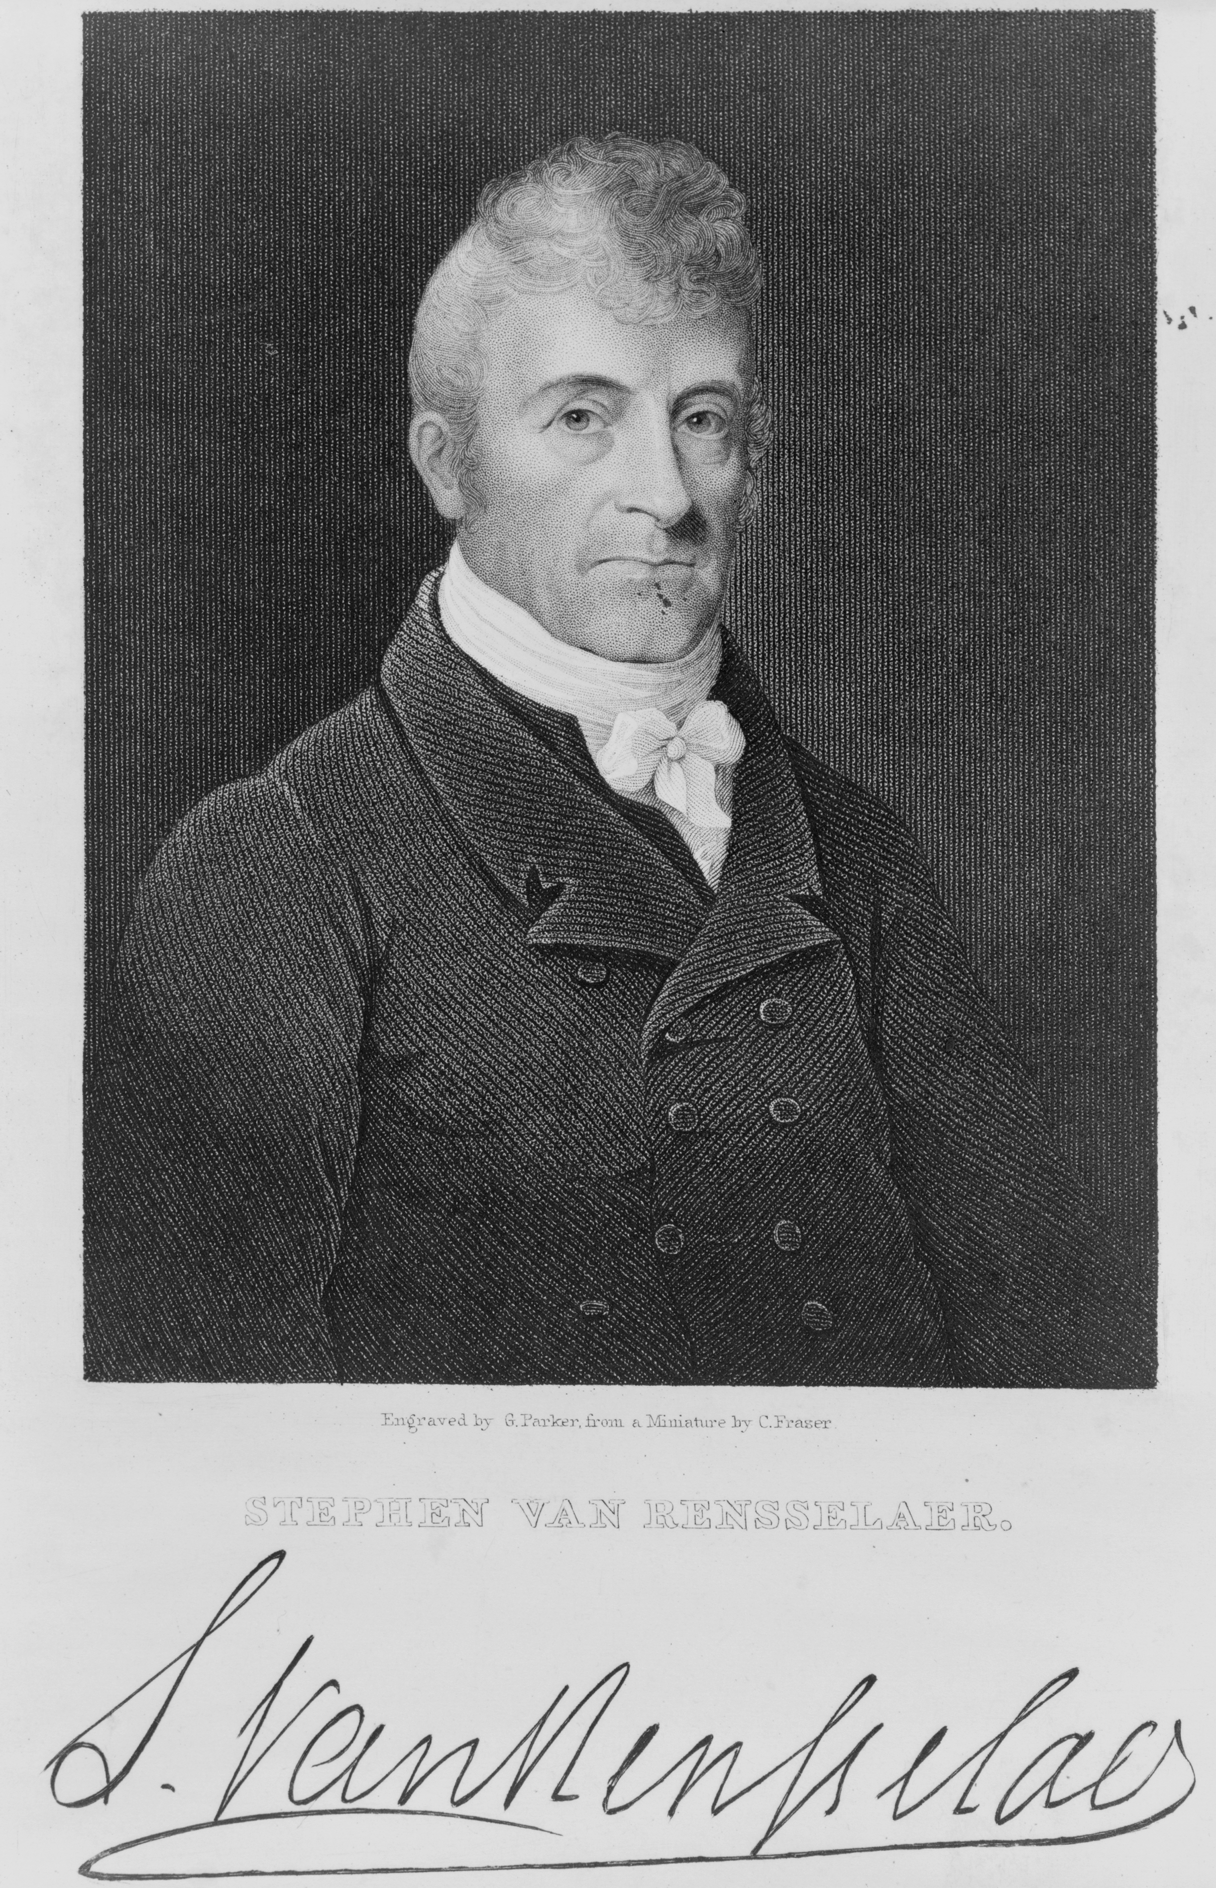
Stephen Van Rensselaer (1764-1839)
Patroon and Federalist
State Militia Major General
10th richest American of all time
“Anti-Rent wars” break out after his death.
Engraving by G. Parker after miniature by C. Fraser
Notes:
http://money.cnn.com/galleries/2007/fortune/ 0702/gallery.richestamericans.fortune/10.html

Slide 7
DeWitt Clinton (1769-1828)
Democratic-Republican rival to Tompkins
Ran for President as Federalist in 1812, lost to James Madison 89 electoral votes to 128
Elected Governor when Tompkins elected Vice-President
Famous for Erie Canal
Rembrandt Peale's portrait of DeWitt Clinton, 1823.

Slide 8
Dryden in 1812
“two grain mills and carding machines… some congregations of Baptists and Presbyterians … 4 or 5 school houses…. in 1810 the population amounted to 1890, … 310 families and 213 senatorial electors…. whole taxable property, as assessed in 1810, $84,099.... 3 turnpike roads … inhabitants are principally farmers whose farms and looms supply much of their common clothing.” – Spafford's N. Y. State Gazetteer, in Goodrich, 33-4
Southern end of Cayuga County (Tompkins formed in 1817)

Slide 9
Dryden in 1812
Pioneer Farmstead, 1809, Genesee Country Museum, Simon St.Laurent

Slide 10
Dryden in 1812
Pioneer Farmstead, 1809, Genesee Country Museum, Simon St.Laurent

Slide 11
Dryden in 1812
Pioneer Farmstead, 1809, Genesee Country Museum, Simon St.Laurent

Slide 12
Dryden Militia
“[George Robertson] was afterward a captain of the State militia and the field opposite the present residence of his son, Mott J. Robertson, upon which this log house was built in 1798, was the training ground for the early yeomanry of Dryden, who were here required to be annually drilled in military tactics.” – Goodrich, 16
Notes:
“The original commission of Major [Peleg] Ellis as captain, issued to him February 11, 1811, by Daniel D. Tompkins, the governor of the state, is one of the relics which were on exhibition at Dryden's Centennial Celebration.”
“Judge John Ellis afterwards went out to "the lines" with the second Dryden company of militia, leaving but fourteen able-bodied men in the township…” (Goodrich, “The War of 1812”)

Slide 13
And from Lansing
Capt. William Armstrong*
Charles Bloom
Gen. Henry Bloom
Charles Hagin
Ephraim LaBarre
Capt. John Leavenworth*
Charles McGuigan*
Maj. Gen. Daniel Minier*
Capt. Joseph North
Robert J. Shaw
Col. Daniel Thorpe*
Caleb Tichenor
Brig. Gen. John Tillotson*
Lt. Ira Tillotson*
Matthew N. Tillotson*
Capt. Jas. Townley
Capt. Thomas Wilbur*
* - from the part of Lansing that became Genoa, Cayuga County

Slide 14
Preparation
“Our ancestors were poorly prepared for either conflict with the mother country, supplied as she was with powerful armaments and standing armies, and it was only the necessities of the occasion which seemed to suddenly call forth and develop in them the courage and heroism which enabled them to succeed. History affords but few instances where an inferior number of untrained men, called suddenly and unexpectedly to arms, have overwhelmingly defeated trained soldiers.” – Goodrich, 30

Slide 15
Local Enthusiasm
“When a call was made for troops in 1812, [Peleg Ellis] marched out on the 26th of August, 1812, in command of the Dryden company for the frontier. The entire company, instead of waiting to stand the draft, volunteered, except one who was unable to go.” – Landmarks of Tompkins County, 248
“When the British burned Buffalo in 1813, the militia was very generally ordered out, as before stated. Captain Slater received his orders and there was much local excitement. The company departed, but after a march of a day and a half reached Canandaigua, where they received notice that the danger was passed and they could return.” – Landmarks, 380

Slide 16
Local Enthusiasm
In Trumansburg, Colonel Hermon Camp recruited and led a cavalry company that served on the Niagara Frontier, “the only cavalry in the war”. – Lydia Sears, History of Trumansburg

Slide 17
Not Just Settlers
“For a few years after the locality around Slaterville was settled by a number of families, a small party of Indians came each fall to hunt in that vicinity. They were Oneidas and were led by one whom the settlers called Wheelock. This Wheelock was killed in the war of 1812, while fighting with the Americans; after that the Indians came to the town no more.” – Landmarks, 274

Slide 18
And Less Enthusiasm
“Several of the Virginian settlers [in Caroline] before described, notably Dr. Joseph and John J. Speed, were members of the company, and, being Federalists, were opposed to the war.
They, however, furnished substitutes….” – Landmarks, 380

Slide 19
Fluid Loyalties
“Charles Hagin, a native of Ireland, born in 1793, who came to America as a soldier in the British army in the war of 1812, being seized in the streets of Belfast and pressed into service.
Reaching Canada, he made his escape to the American side, and a few days later lost his arm in the battle of Lundy's Lane, in the American cause. After leaving the hospital he came to Lansing, where he taught school.” – Landmarks, 274
Marker at Laura Secord House, photo by Simon St.Laurent

Slide 20
Meanwhile, in Canada
George Prévost, Governor General of Canada, based in Lower Canada (Quebec)
Issues strict orders for defense only.
Upper Canada (Ontario) an unsettled mix of loyalists, Americans, traders, and trappers.
Upper Canadians not especially eager for war, often take leave for harvest and other work.
Notes:
(Astor’s message)
Communications – riders, bugles, fife and drum.
Supply Lines – long and difficult to defend.
Weapons and Tactics – firing as a group, bayonets.
Parole for the Captured – only regulars normally kept as prisoners.
Little Cavalry – too hard to supply horses.
War on the cheap – should be easy, right?

Slide 21
Isaac Brock
British Army since 15
Canada since 1804
Commander and executive, Upper Canada
Far more bellicose than Prevost, circumvents defensive orders.
Soldiers loved him, civilians not so much
Notes:
(Astor’s message)
Communications – riders, bugles, fife and drum.
Supply Lines – long and difficult to defend.
Weapons and Tactics – firing as a group, bayonets.
Parole for the Captured – only regulars normally kept as prisoners.
Little Cavalry – too hard to supply horses.
War on the cheap – should be easy, right?

Slide 22
A Different World
Communications
Supply lines
Weapons and tactics
Parole for captured soldiers
Little cavalry
War on the cheap
Notes:
(Astor’s message)
Communications – riders, bugles, fife and drum.
Supply Lines – long and difficult to defend.
Weapons and Tactics – firing as a group, bayonets.
Parole for the Captured – only regulars normally kept as prisoners.
Little Cavalry – too hard to supply horses.
War on the cheap – should be easy, right?

Slide 23
Bad News from the West
Fort Michilimackinac ambushed before Americans received word of war, surrenders. Gives British control of route to Lake Michigan
Disaster at Fort Detroit. After brief invasion of Canada, General William Hull retreats to Detroit, freezes, surrenders to British troops under Isaac Brock. Reinforcements arrive after surrender.

Slide 24
Nothing from the East
Little movement on the St. Lawrence
Instead of moving up the Champlain Valley, General Dearborn wanders to Boston to try to talk with Federalist Governors about sending their militia. Fails.
Temporary truce negotiated between Canadian Governor-in-Chief Prevost and General Dearborn.

Slide 25
Why the Niagara?
By Pfly, Creative Commons Attribution-ShareAlike 3.0

Slide 26
The Setting: The Niagara River
Key connection from the St. Lawrence River and Lake Ontario to the interior Great Lakes.
Natural US-Canada border, with falls, gorge, rapids.
Because of fur trade, more developed than most of Western NY and Upper Canada.
Niagara Falls, Simon St.Laurent

Slide 27
French Forts on the Niagara, 1678-1759
Critical water connection to the Great Lakes
But, the Falls
So, fortify existing portage route, starting above the falls: Fort Little Niagara, “upper landing”
And ending just across the Niagara Escarpment: Fort Joncaire, “lower landing”
Map by Simon St.Laurent, based on Map of the Niagara Frontier, Benson J. Lossing, 1869.

Slide 28
British Forts on the Niagara, 1764-1796
After the French and Indian War, the Niagara is British.
Most fort names change, and Fort Erie is built.
Lewiston is first easy access to river north of Niagara Escarpment. British built “cradles” tramway at Fort Demmler.
Map by Simon St.Laurent, based on Map of the Niagara Frontier, Benson J. Lossing, 1869.
Notes:
Devils Hole Massacre (1763) – Seneca attack during Pontiac’s rebellion. Kill 81, wound 8.

Slide 29
British and American Niagara, 1812
The British were supposed to leave Fort Niagara etc. in 1783 but only depart in 1796, after Jay’s Treaty.
Fort Demmler becomes Lewiston.
Construction boom on the Canadian side: Fort George, Chippewa to Queenston portage.
Map by Simon St.Laurent, based on Map of the Niagara Frontier, Benson J. Lossing, 1869.

Slide 30
Facing Off Across the River
Fort Niagara from Fort George, Benson J. Lossing, 1869.

Slide 31
The Niagara Campaign, Fall 1812
Both sides use the truce to arm and fortify.
Truce ends September 8th.
Americans seize the Caledonia and Detroit from Fort Erie October 8th.
Van Rensselaer orders attack October 10th, but cancels it after terrible weather and loss of Lieutenant Sims’ boat with all the oars.
Americans face persistent lack of basic supplies.

Slide 32
How Many Troops on the Niagara?
Malcomson estimates:
American
2484 regulars
4070 New York militia
160 Pennsylvania militia
5206 total
British
1224 regulars
813 militia
300 Grand River Nations
2337 total

Slide 33
British Queenston, 1812
The Lower Niagara, with parallel portages and forts.
Regular crossings between Fort George and Fort Niagara, Queenston and Lewiston.
Queenston a hub because of the portage route.
Map by Simon St.Laurent, based on Map of the Niagara Frontier, Benson J. Lossing, 1869.

Slide 34
Queenston, 1812
Queenston, Benson Lossing (1869)

Slide 35
Queenston, 1812
Laura Secord House, Simon St.Laurent

Slide 36
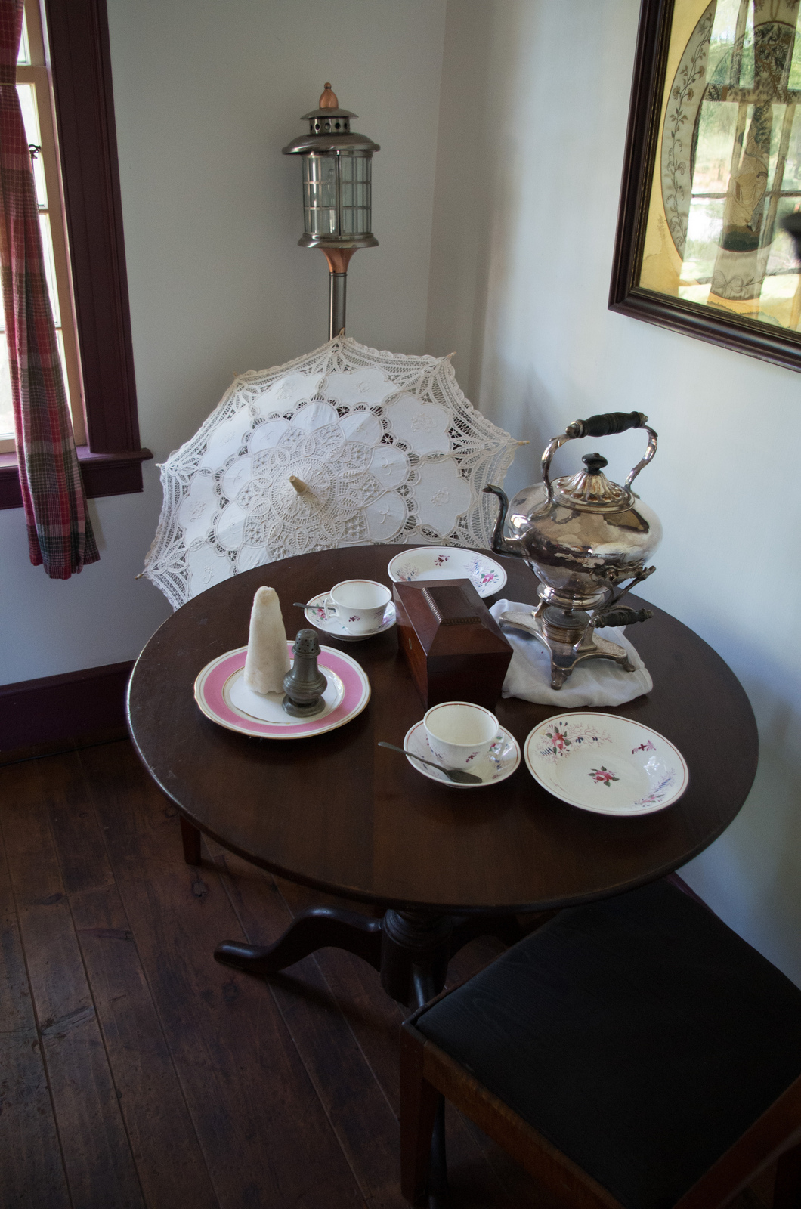
Queenston, 1812
Laura Secord House, Simon St.Laurent

Slide 37
The Battle of Queenston Heights
Van Rensselaer “became satisfied that my refusal to act might involve me in suspicion, and the service in disgrace.”
Abandons plans for a diversion.
Races to reassemble troops, cross river.

Slide 38
Gathering Troops and Supplies
Only 13 batteaux. 39 hauled from Oswego and more at Fort Schlosser remain unused.
Basic supplies arriving at the last minute. Regular arguments between Van Rensselaer and Quartermaster General Peter Porter.
British notice something up – Evans and “Toock”.

Slide 39
Regulars, Militia, and the American Chain of Command
Brigadier General Alexander Smyth – started toward Lewiston with 1200 for initial attack in rain, turned around when cancelled, won’t come out from Black Rock again.
Lieutenant Colonel Winfield Scott – arrives late. Van Rensselaer won’t include him in crossing, but sets up guns in Lewiston. Crosses later, assumes command by end of battle.
Notes:
Smyth later fails at Frenchman’s Creek, similarly unable to get his army across the Niagara in boats.

Slide 40
Lieutenant Colonel Henry Bloom’s 19th
Bloom, from Lansing, commands Cayuga County’s 19th Regiment of Wadsworth’s 7th Detached Brigade.
409 men, according to the muster.
Called to Niagara August 15th, 1812 by Van Rensselaer.
September 1st, VR hopes they brought tents.
September 27th, “protect the boats in Gill Creek.”
Left Niagara Falls at 9pm on October 12th for Lewiston.
Notes:
Muster from A Very Brilliant Affair, 257
Orders from Solomon Van Rensselaer A Narrative of the Affair of Queenstown.

Slide 41
Challenging Landscape
Niagara Escarpment just south of both Lewiston and Queenston.
The slope to the Niagara River is often steep.
Niagara River isn’t rapids, but swirls with unusual currents.
US Geological Survey Map, 1980

Slide 42
Artillery
Canadian artillery at two mile intervals, arrived in July.
American artillery brought to new Lewiston docks and “Fort Gray” on escarpment for battle.
Mortars, 6, 9, 12, and 18-pound guns.
Map by Simon St.Laurent, loosely based on A Very Brilliant Affair, p. 122

Slide 43
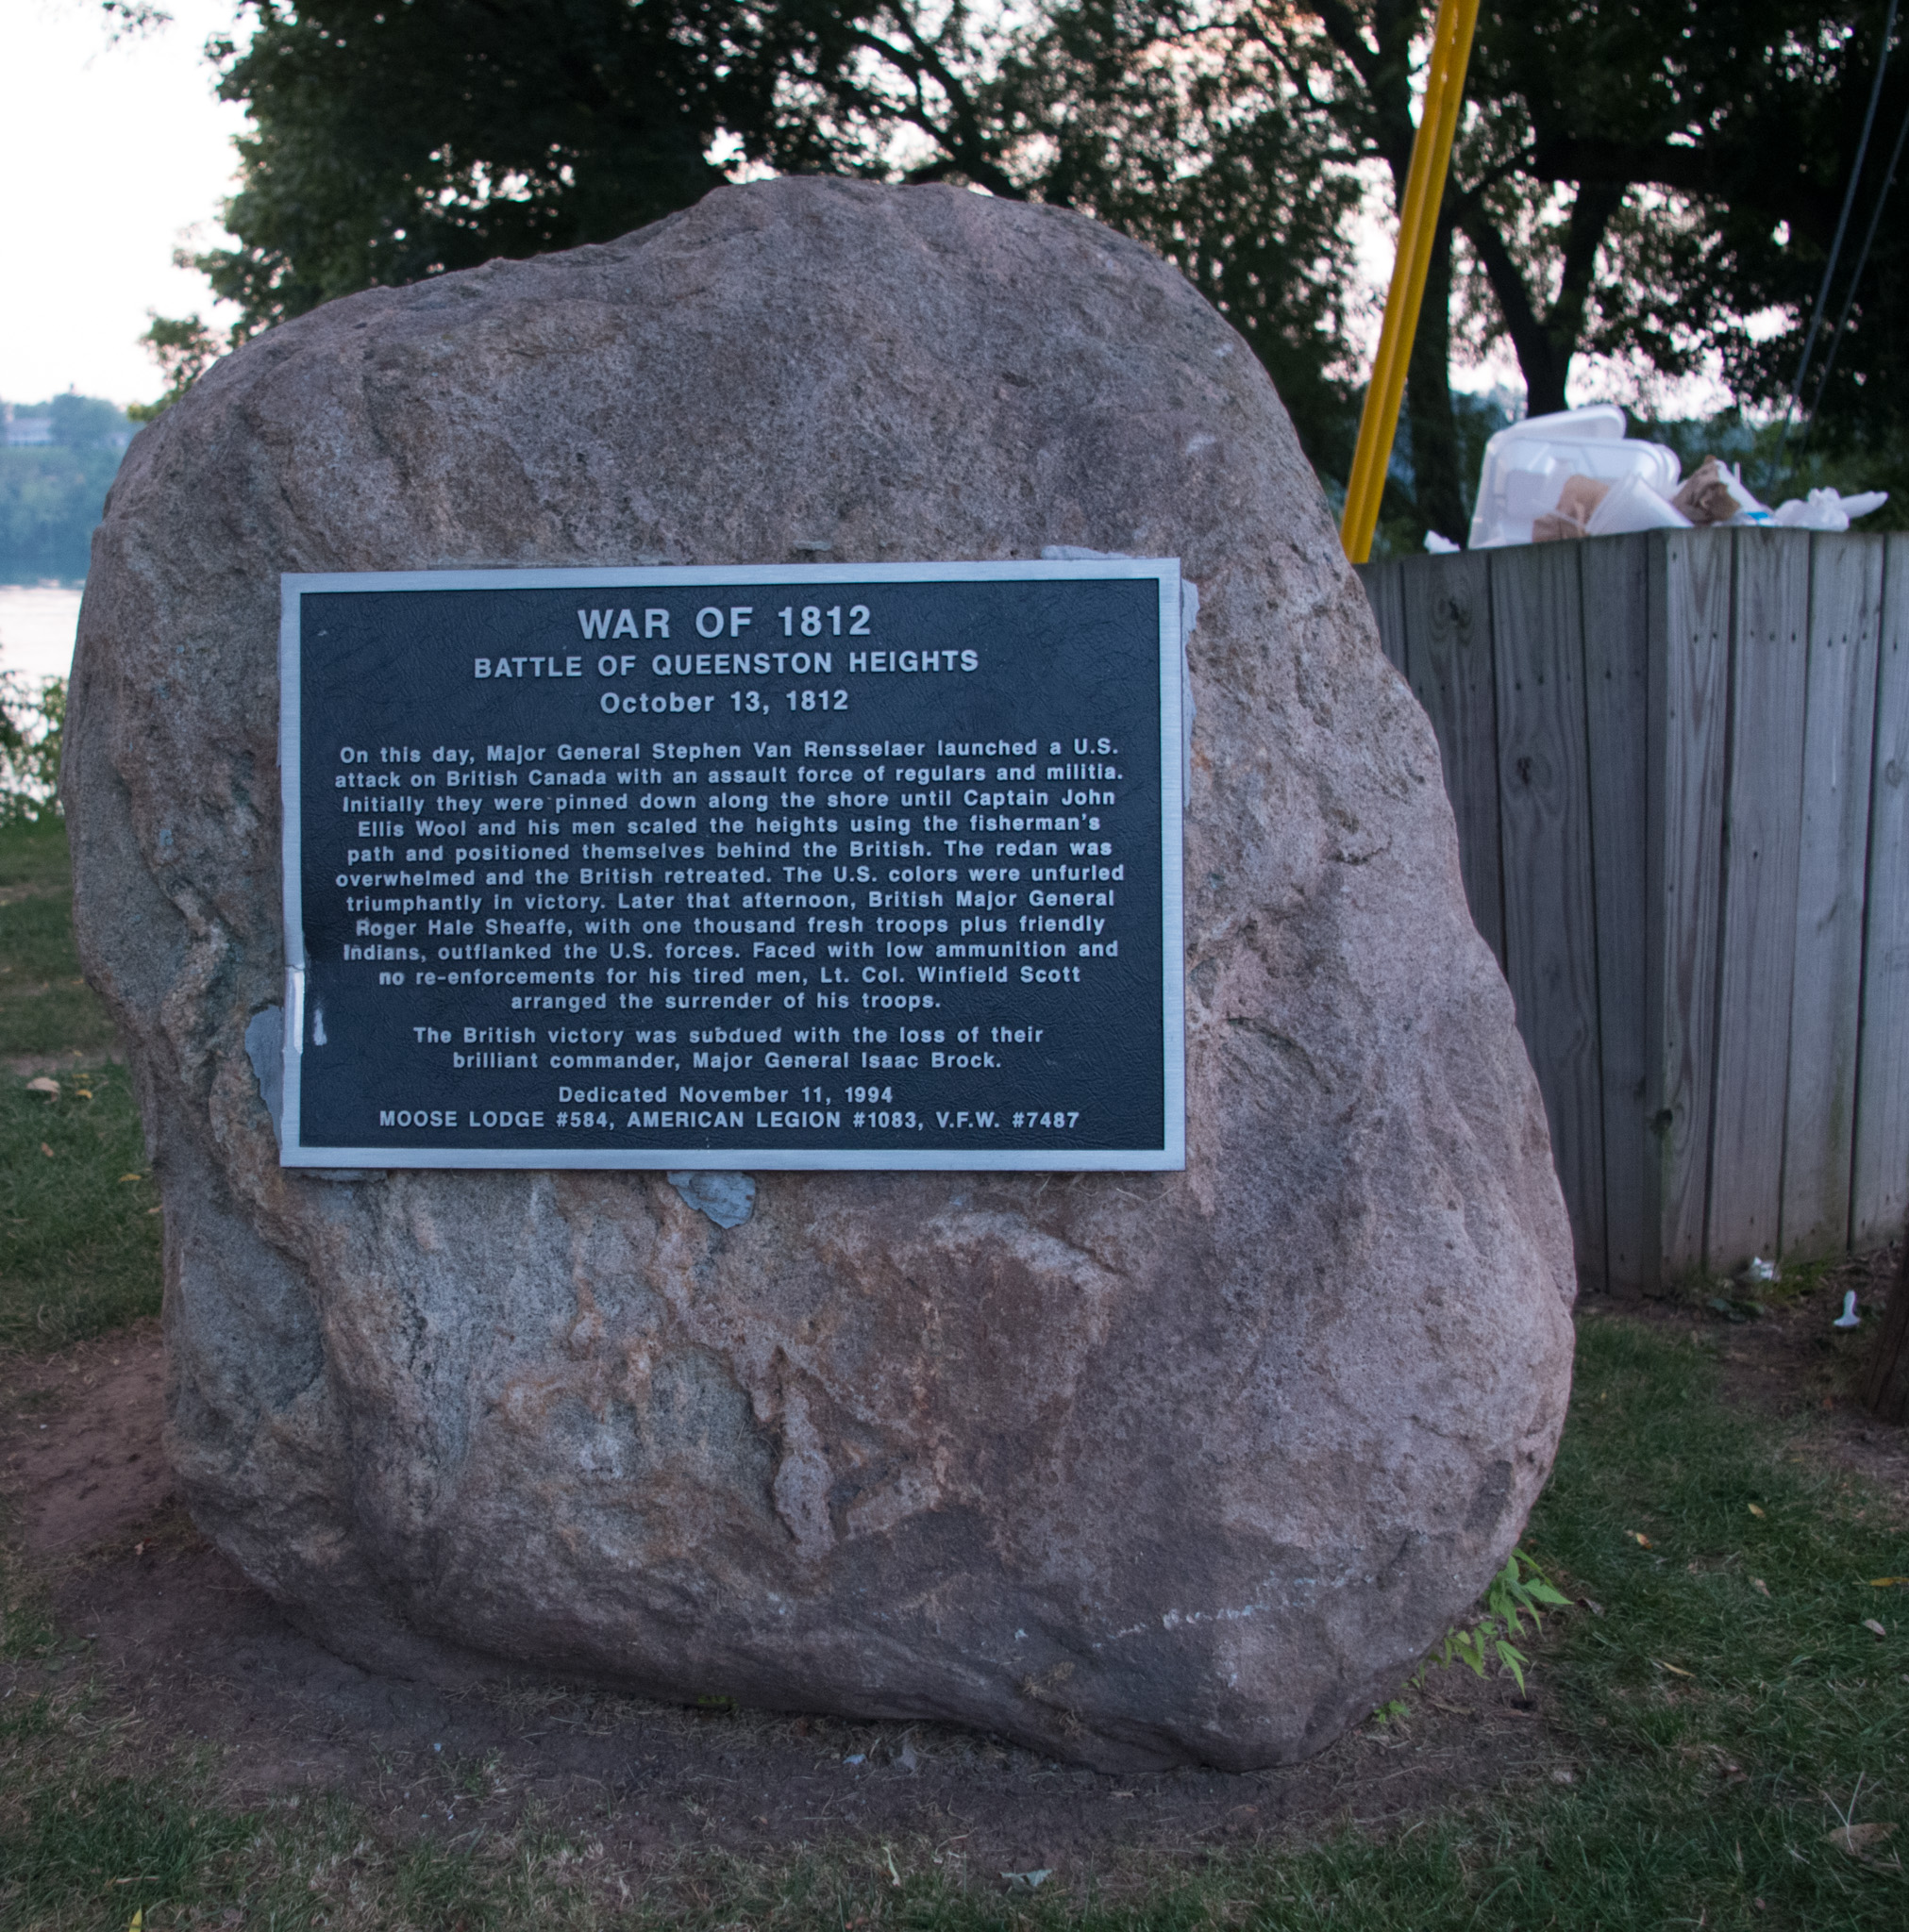
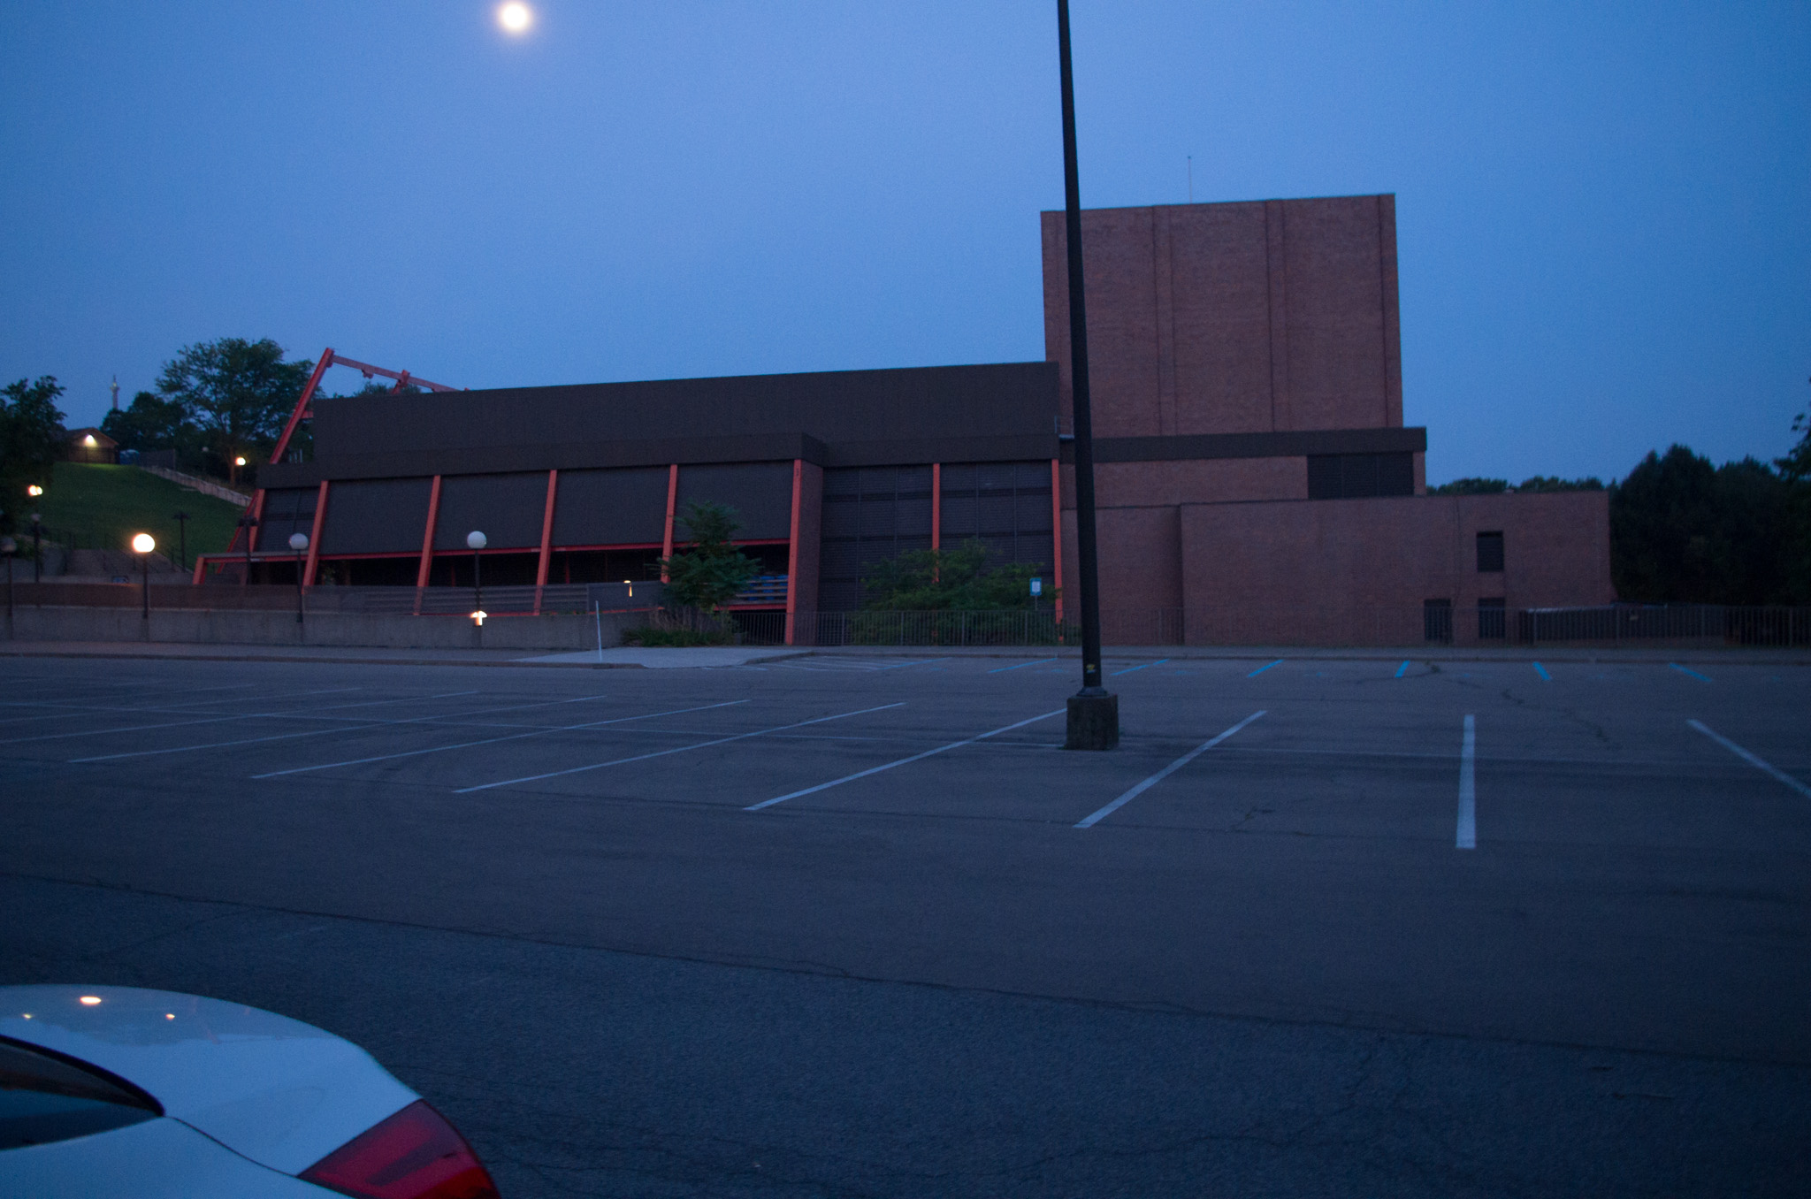
Launch from Lewiston Lower Landing
Historic marker for battle at main Lewiston docks, but starting point a mile south.
Lower Landing now part of Artpark; signs, but tricky to find. Forts Joncaire and Demmler have signs.
Notes:
Based on A Very Brilliant Affair; quote from A Narrative of the Affair of Queenstown, 21-22. Lower Landing, but “upper ferry” in Lewiston.

Slide 44
Why the Lower Landing?
“Experienced boatmen were procured to take the boats from the landing below to the place of embarkation.”
British artillery controlled the river further north.
Distance to Queenston shore much shorter.
Lower Landing still fairly established.
Notes:
Based on A Very Brilliant Affair; quote from A Narrative of the Affair of Queenstown, 21-22. Lower Landing, but “upper ferry” in Lewiston.

Slide 45
The Departure Site
Artpark, Lewiston, NY, Simon St.Laurent

Slide 46
Launching from the Shore
Artpark, Lewiston, NY, Simon St.Laurent

Slide 47
3 to 5 am: Establishing a Beachhead
First wave nearly all regulars (by accident).
13 boats, 300 men, landed 500 yards upriver from Queenston.
Discovered, fired upon.
1 boat (Chrystie) meanders.
Officers injured or killed, but beachhead safe from artillery fire established.
Map by Simon St.Laurent, loosely based on A Very Brilliant Affair, p. 139

Slide 48
The Queenston Heights Shore
Queenston Heights from Artpark, Lewiston, NY, Simon St.Laurent

Slide 49
6am: Second Wave
“On my return to the upper ferry, I found there a scene of confusion hardly to be described. The enemy concentrated their fire upon our embarking.”
More regulars come across.
Wayward boats land downstream; fight goes badly. Some escape.
Map by Simon St.Laurent, loosely based on A Very Brilliant Affair, p. 149
Notes:
Quote from Chrystie, 211-2

Slide 50
Lewiston Landing from Queenston Heights
View from Queenston Heights Walking Tour, Simon St.Laurent

Slide 51
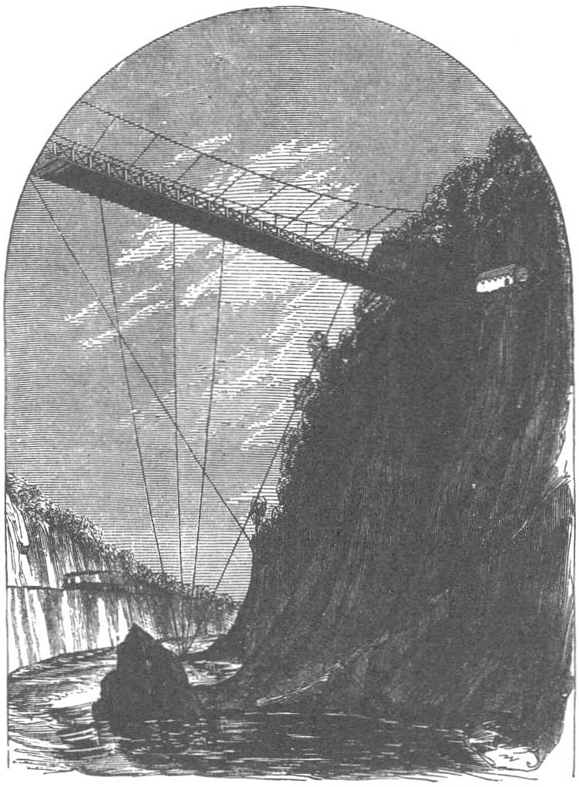
7:00 am: Up the Cliff to the Redan
Led by Captain John Ellis Wool, regulars scale “a fisherman’s trail” that has since disappeared.
A 2012 re-enactor scrambled up cliff; took about an hour.
Largely unnoticed until troops reached the top, because British considered the cliff impassable.
Approaching Queenston Heights, Benson Lossing (1869)

Slide 52
The Redan
18-pounder on Queenston Heights Walking Tour, Simon St.Laurent

Slide 53
7:00 am: Brock’s Arrival
Major General Isaac Brock, hero of Detroit, races from Niagara, aides following.
Brock reaches the redan just before Americans surprise and seize it.
Canadians had retreated to village, leaving redan lightly defended.
Map by Simon St.Laurent, loosely based on A Very Brilliant Affair, p. 149

Slide 54
Redcoats Firing
Photo by Simon St.Laurent

Slide 55
7:30 am: Brock’s Charge
General Brock escapes to village, prepares charge.
Leads charge personally – rare successful single shot kills the general.
Canadians retreat. Second charge under Macdonnell has same result.
Canadians retreat from Queenston village.
Map by Simon St.Laurent, loosely based on A Very Brilliant Affair, p. 154
Notes:
“The boldest measures are the safest”, except when they aren’t.

Slide 56
Brock’s Death, Re-imagined
General Brock at the Battle of Queenston Heights by John David Kelly (1862 – 1958). Published 1896.
Notes:
Wrong in so many ways, but Brock did perish.

Slide 57
9 am: Third Wave
Probably when the Dryden militia went over.
“Aaron Cass, one of the Dryden company from near Ellis Hollow, was struck on the head by a British cannon ball and instantly killed while the regiment was crossing the Niagara river in boats to take part in the battle of Queenston. Cass had been a distinguished soldier of the Revolution from Connecticut, was a brother-in-law of Aaron Bull, and settled in Ellis Hollow in 1804.
Other soldiers of the Dryden company were Aaron Genung, from near Varna; Arthur and Stephen B. June, Marcus Palmerton, Jonathan Luce, George McCutcheon and Peter Snyder.” – Goodrich, 32

Slide 58
“Death, Hell, or Canada”
“As the Dryden company were crossing the Niagara river to the Canada side, Stephen B. June, impressed with the importance of the occasion and boiling over with the true martial spirit, arose in his boat and swinging his hat defiantly called out as the watchwords of the expedition: “Death, Hell, or Canada." This was early in the morning of the day when everything was hopeful and few of the enemy were in sight. The battle of the morning was successful. A landing on the Canada shore was effected, the Queenston Heights were gallantly scaled and captured and the Commanding General Brock of the enemy was mortally wounded in the conflict.” – Goodrich, 32

Slide 59
10am to 1 pm: Unsteady Victory
Chaos continues at the boats.
Orders to fortify Queenston position fail because no entrenching tools available.
Some American supplies to Queenston village landing.
Map by Simon St.Laurent, loosely based on A Very Brilliant Affair, p. 175

Slide 60
To Queenston Village
From Lower Landing to Queenston waterfront, Simon St.Laurent

Slide 61
2 pm: British regroup
British artillery target American artillery.
Grand River Nations arrive from south, commanded by John Norton and John Brant.
War-whoops terrify Americans on both sides of river.
John Brant, Mohawk leader Benson Lossing (1869)

Slide 62
Grand River Nations
Photo by Andres Musta at 2012 reenactment. (CC license)

Slide 63
Bombardment Along the Niagara
Apart from the battlefield itself, artillery starts firing up and down the river.
British Fort Erie vs. American Black Rock. Black Rock magazine explodes, ending duel.
American Fort Niagara vs. British Fort George.
Photo by Simon St.Laurent, taken at Fort George

Slide 64
With the Roof Off
A Soldier’s Wife at Fort Niagara.
Photo by Simon St.Laurent, taken at Fort Niagara
Notes:
Betsy Doyle in November 1812. Escapes fall of fort in December 1813, arrives in Greenbush April 1814 with four children through winter. Husband Andrew captured at Queenston, spent war at Dartmoor Prison, returned 1815. Never reunited; Betsy died in poverty.

Slide 65
Fort Niagara’s Secret Weapon
Shot oven heats cannonballs so they’ll still be hot on arrival.
Much of Niagara-on-the-Lake burns.
At Fort Niagara, Simon St.Laurent

Slide 66
Saving the Fort George Magazine
Picture on display at Fort George

Slide 67
2 pm: No Reinforcements
American militia won’t cross. No new regulars.
Wounded Lt. Col. Bloom crosses back, exhorts militia to cross. Returns to battle alone.
“All this transaction took place in fair view of two thousand militia on the opposite shore (poor dastardly wretches) who would not come to our assistance – had they come we might have held our ground…” – Jared Willson, 20th Regiment
Notes:
Quote from The War of 1812: Writings from America’s Second War of Independence, 161. Willson was from Canandaigua and was captured and paroled.

Slide 68
3 pm: Sheaffe’s Approach
British General Sheaffe gathers troops, goes around to attack from south.
British regulars (41st) from north.
Norton, regulars, and militia from west.
Map by Simon St.Laurent, loosely based on A Very Brilliant Affair, p. 190

Slide 69
Final Battle
Photo by Andres Musta at 2012 reenactment. (CC license)

Slide 70
4 pm: Surrender
Americans forced down to original beachhead
In chaos of battle, takes three attempts to surrender.
Map by Simon St.Laurent, loosely based on A Very Brilliant Affair, p. 190

Slide 71
How Many Troops in the Battle?
Malcomson estimates:
American
613 regulars crossed
371 NY militia crossed
369 NY militia possible
103 regular artillery
71 militia artillery
Total around 1530
British
613 regulars
613 militia
40 regular artillery
40 militia artillery
100 Grand River Nations
1366 total

Slide 72
Aftermath
“Not seeing his townsman, Stephen B. June, among the prisoners, Captain Ellis went back on the battle field to look him up, and after searching found him very severely wounded by a ball which had entered his mouth and passed out of the back of his neck, just below the base of the skull, fortunately missing the spinal cord. Finding that June was alive and still conscious, although fearfully wounded, Captain Ellis asked him which it was now, "Death, Hell, or Canada," to which the wounded soldier feebly but firmly replied: "I can't tell quite yet, Captain, which it is, but when the British bullet struck me I thought I had them all three at once." June lived to return home and, if we are not mistaken, some of his family descendants are still inhabitants of the town.” – Goodrich, 32-3

Slide 73
How Many Casualties?
60 known American dead, 170 wounded.
436 American regulars captured, 489 militia.
20 British dead, 85 wounded.
5 Grand River Nations militia killed, many wounded (including John Norton).
Isaac Brock

Slide 74
Parole and Continuation
Militia (including 40 Dryden men) paroled quickly with a promise not to fight until exchanged for British prisoners.
Governor Tompkins arrives October 23rd.
Brigadier General Alexander Smyth (regular) takes command of the Niagara.
Truce until November 20th.
Smyth’s attempts on Fort Erie and Chippewa fail November 28th and 30th.

Slide 75
Governor’s Race, 1813
Tompkins: 43,324
Van Rensselaer: 39,718

Slide 76
Niagara: 1813
May: Americans take Fort George and Fort Erie, control western shore.
June: British/Canadian victories at Stoney Creek and Beaver Dams halt American momentum.
December: Americans abandon Fort George, Fort Erie. British take Fort Niagara, burn American settlements from Lewiston to Buffalo.

Slide 77
Niagara: 1814
July: Americans retake Fort Erie
July: British and Canadians halt Americans at Battle of Lundy’s Lane
August: Americans withstand siege of Fort Erie
November: Americans evacuate Fort Erie.
American Infantry attacks, Lundy’s Lane

Slide 78
War on the St. Lawrence
Cape Vincent re-enactment. Photos by Susan Verberg, used by permission
Notes:
1813 attempted invasion of Montreal by way of Ogdensburg, stopped by Battle of Crysler’s Fam. Americans never especially try to blockade the river.

Slide 79
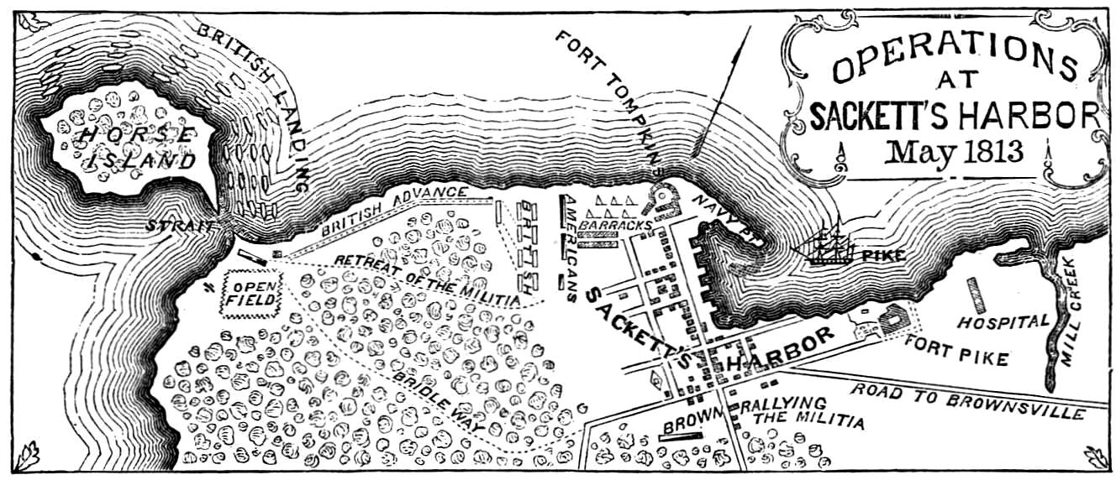
New York through the War
Lake Ontario never really under American control, though Toronto (York) burns.
Oswego attacked by British; Sackets Harbor unstable base.
“We have met the enemy and they are ours.” Oliver Hazard Perry gives US control of Lake Erie. Points west follow.
Plattsburgh and the Battle of Lake Champlain end British invasion September 1814.
Plan of Battle of Sackett's Harbor, from Lossing's Pictorial Field Book of the War of 1812 (1868)
"The attack on Fort Oswego, May 6, 1814”.
Drawing by L. Hewitt, engraving by R. Havell

Slide 80
At Sea, American surprise
Holds its own against the most powerful navy in the world
Don’t win every battle, but win enough to raise American spirits and lower British ones.
USS Constitution and HMS Guerriere by Michel Felice Corne (1752-1845)

Slide 81
Rockets’ Red Glare
British take the Chesapeake Bay in 1814.
Burn Washington as retaliation for York.
Bombard Fort McHenry but don’t invade Baltimore.
“The Star-Spangled Banner” our main memory.
A VIEW of the BOMBARDMENT of Fort McHenry, near Baltimore

Slide 82
Peace
British slow to negotiate; feel they have advantage.
Americans default on debt, flirt with bankruptcy.
Treaty of Ghent signed Christmas Eve, 1814. Restores original borders.
Ratified February 1815.
Amédée Forestier, The Signing of the Treaty of Ghent, Christmas Eve, 1814

Slide 83
A Little More War
British assault New Orleans January 8, 1815.
American victory after peace treaty signing establishes Andrew Jackson’s reputation, gives Americans happier conclusion to indecisive war.
The Battle of New Orleans
by Henry Bryan Hall
after William Momberger
Notes:
Americans: 55 killed, 185 wounded, 93 missing.
British: 386 killed, 1521 wounded, 552 missing.

Slide 84
Slow Recovery for Some
“grandfather of Bradford Almy [had] patriotic blood in his veins, and in 1812 he enlisted, served honorably, and was twice wounded at Lundy's Lane. In the then primitive condition of surgery, the bullets could not be removed from his body, though he passed much time in hospitals and suffered several operations. He died in Ithaca, at No 53 North Aurora street, in May, 1823.”
Medical Kit at Fort George, Simon St.Laurent

Slide 85
Dryden After the War
“The census of 1810 having shown a population in the town of 1890, that of 1814 shows an increase to 2545, while that of 1820 returns a population of 3995, showing a very rapid increase and reaching, near the end of the first quarter of the Century Period, a number slightly exceeding that of the present population, the highest number ever reached being 5851 returned in 1835” – Goodrich, 33-35

Slide 86
Peleg Ellis After the War
“At the conclusion of the battle, together with about forty of the Dryden men, was among the prisoners of war; but they were immediately paroled and sent home. Like some others, Major Ellis acquired in his army experience the habit of the intemperate use of intoxicating drink and in after years when he indulged too freely his martial spirit manifested itself, and he would go through the manual of arms, in imagination commanding his company as of yore, with all the preciseness and dignity of actual military service.”

Slide 87
Peleg Ellis After the War
“As his years grew upon him, however, he came to realize that his intemperate habits, first acquired in the army, were a detriment to him, and with a resolution stronger than many men of our times can muster, he suddenly broke himself of the growing habit and his last few years were characterized by his strict sobriety and a religious life.” – Goodrich, 193-4
Photo from Goodrich, p. 192

Slide 88
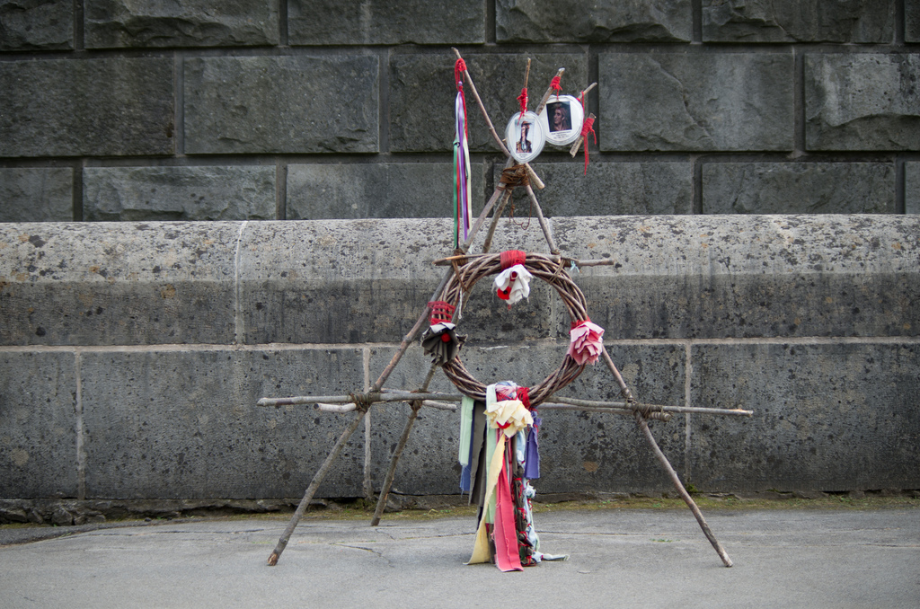
Memory
Canadians venerate Brock as founding hero.
Americans have national anthem and a few parks.
Native Americans / First Nations remember.
Brock cenotaph and monuments, Queenston, Simon St.Laurent

Slide 89
For More
Malcomson, Robert. A Very Brilliant Affair: The Battle of Queenston Heights, 1812. Naval Institute Press, 2003.
Goodrich, George B. The Centennial History of the Town of Dryden, 1797-1897. Dryden Herald Steam Printing House, 1898.
Hickey, Donald (ed.). The War of 1812: Writings from America’s Second War of Independence. Library of America, 2013.
Berton, Pierre. Pierre Berton’s The War of 1812. Doubleday Canada, 2011.
Taylor, Alan. The Civil War of 1812. Knopf, 2012.
Graves, Dianne. In the Midst of Alarms: The Untold Story of Women and the War of 1812. Robin Brass Studio, 2007.
Hickey, Donald, and Clark, Connie. The Rockets’ Red Glare: An Illustrated History of the War of 1812. Johns Hopkins, 2011.

